Slide 1
7.2 One-versus-All Multi-Class Classification

Slide 2
Many classification problems have more than two classes:
face recognition
hand gesture recognition
general object detection
speech recognition
…
Having just two sides, a single linear separator is fundamentally insufficient as a mechanism for differentiating between more than two classes of data.

Slide 3
Here we will see how to overcome this shortcoming when dealing with C>2 classes by learning C linear classifiers (one per class), each distinguishing one class from the rest of the data.
This basic scheme is called One-versus-All multi-class classification.

Slide 4
Notation and modeling

Slide 5
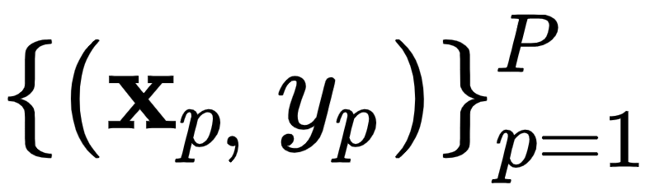
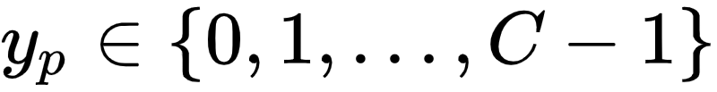
A multiclass dataset
consists of C distinct classes of data.
Although we can in theory use any C distinct labels to distinguish between the classes, it is convenient to use label values .

Slide 6
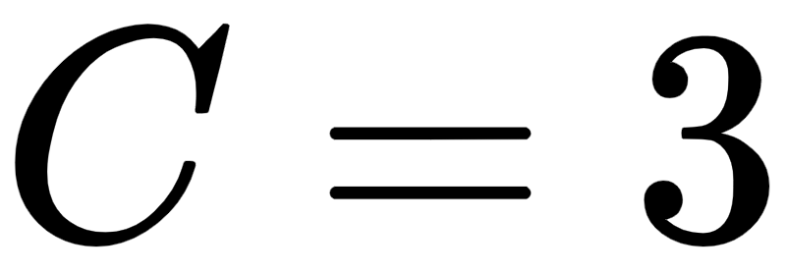
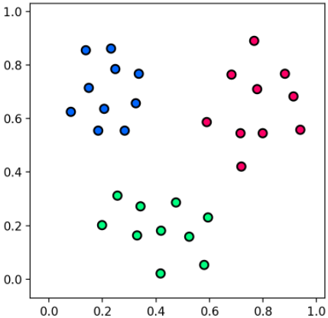
A prototypical toy class dataset.

Slide 7
Training ‘C’ One-versus-All classifiers

Slide 8
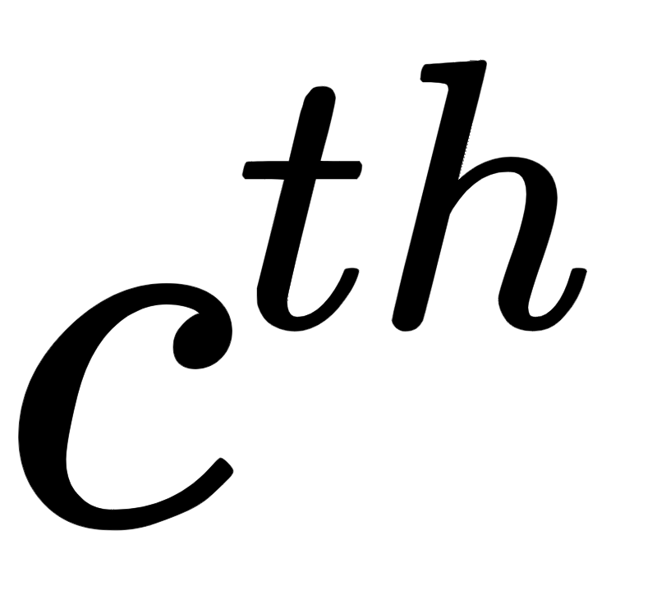
The goal:
We want to learn how to distinguish each class of our data from the other C-1 classes.
One solution:
Learn C two-class classifiers on the entire dataset (with the classifier trained to distinguish the class from the remainder of the data).

Slide 9
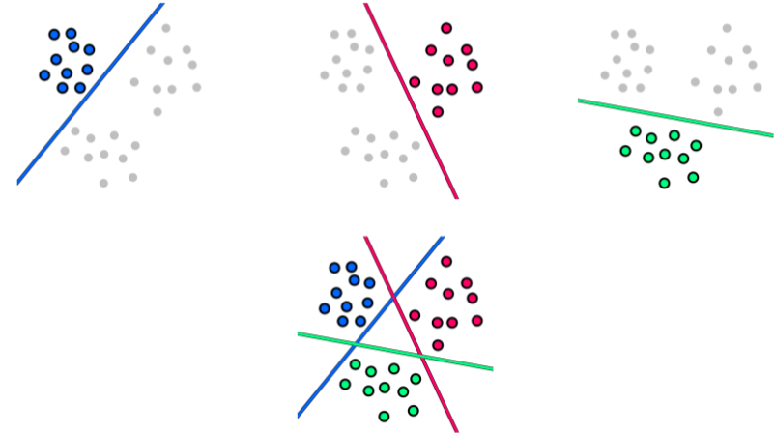

Slide 10
The three places a point in the space can end up (w.r.t our classifiers):
1. On the positive side of a single classifier
2. On the positive side of more than one classifier
3. On the negative side of all classifiers

Slide 11
Points on the positive side of a single classifier

Slide 12
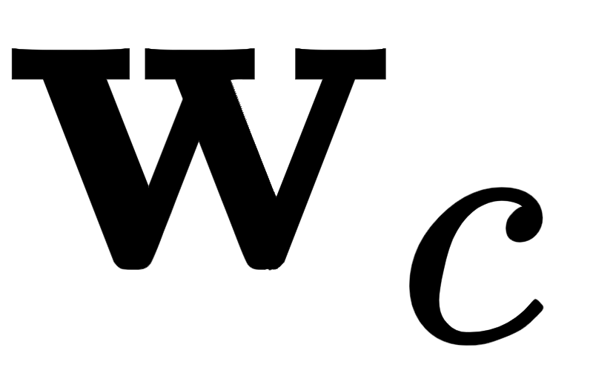
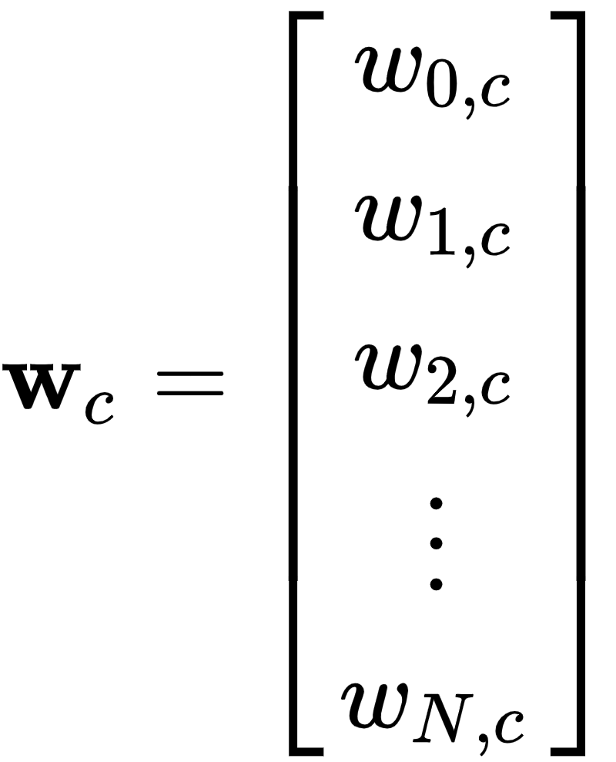
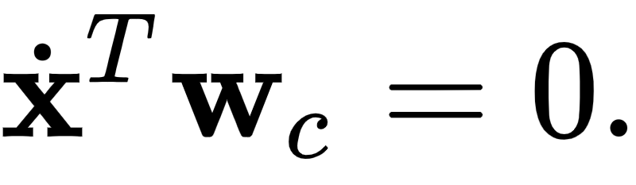
Denoting the weights from the classifier as
then the corresponding decision boundary can be written as

Slide 13
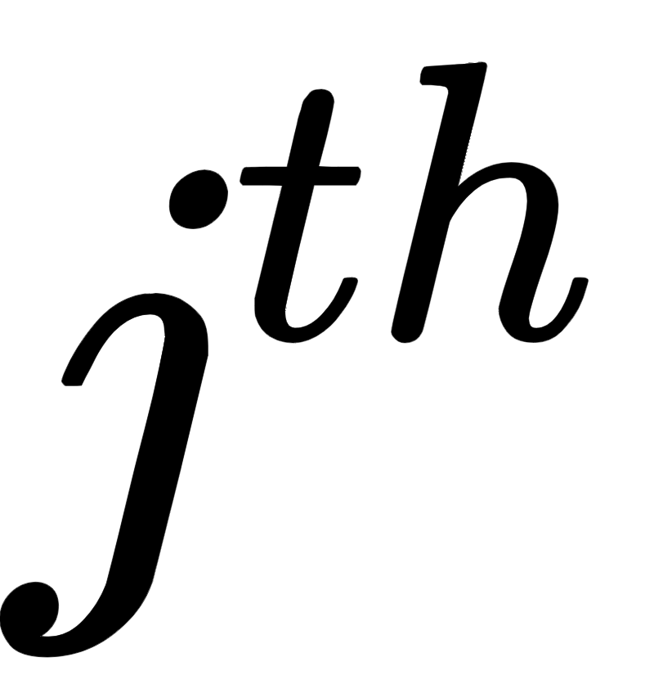
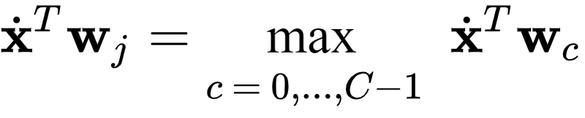
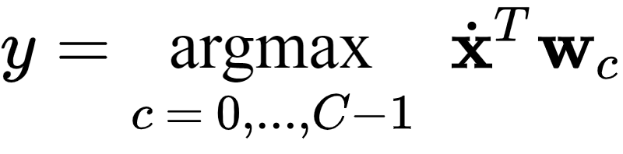
The points that lie solely on the positive side of the classifier only should clearly belong to the class.
They clearly satisfy the condition
Therefore to get the associated label y for these points, we can write

Slide 14
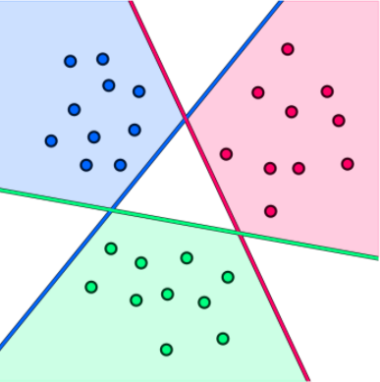

Slide 15
Points on the positive side of more than one classifier

Slide 16
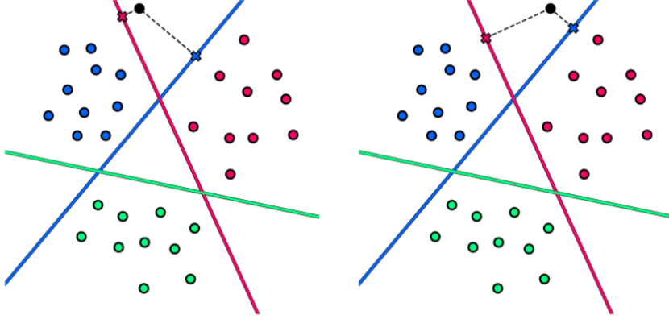
Which class should we assign each point to?

Slide 17
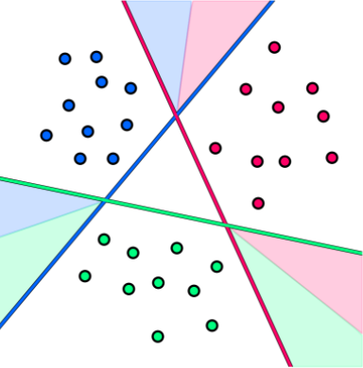
If we repeat this logic for every point on the positive side of more than two classifiers ...

Slide 18
Classification rule: in these regions we have assigned each point to the class whose boundary is at the largest nonnegative distance from it.
How do we compute the distance of an arbitrary point to each of our decision boundaries?

Slide 19

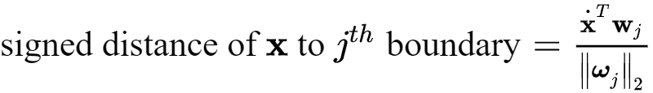
As discussed in [Section 6.3], the signed distance of an arbitrary point to the linear decision boundary is equal to the evaluation at this boundary provided we normalize its parameters by the magnitude of its feature-touching weights

Slide 20
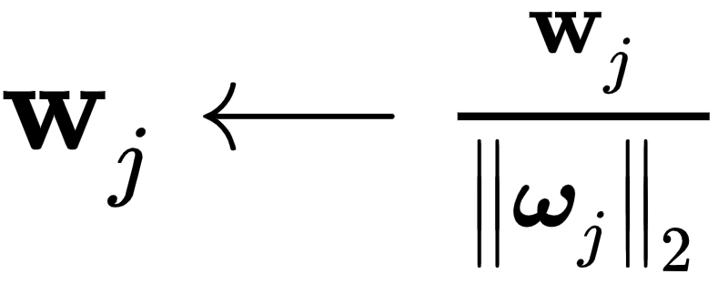
If we normalize the weights of each linear classifier by the length of its normal vector as
then this distance is simply written as the raw evaluation of the point via the decision boundary as

Slide 21
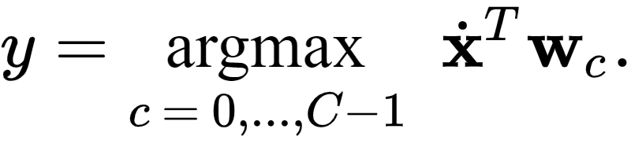
Therefore again - after weight-normalization - we have precisely the same prediction rule we found originally for regions of the space where only a single classifier is positive

Slide 22
Points on the negative side of all classifiers

Slide 23
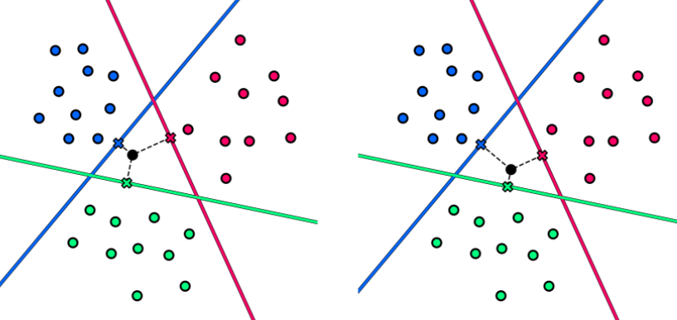
In this case we cannot argue that one classifier is more 'confident' in the class identity of such points. However, we can ask which classifier is the least 'unsure' about the class identity of such points?

Slide 24
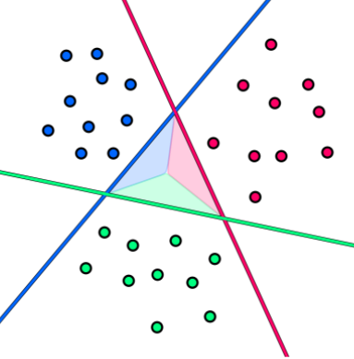
If we repeat this logic for every point in the region ...

Slide 25
Classification rule: we assign a point to the class whose boundary is at the largest signed distance from it.
Expressed algebraically, once again we have

Slide 26
Putting it all together

Slide 27
We have now deduced that the single rule for assigning a label ‘y’ to a point
which assigns the label based on the maximum signed distance of this point to each classifier, applies to the entire space of our problem.
We call this the fusion rule since it tells us precisely how to fuse our C individual classifiers together to make a unified and consistent classification across the entire space of any dataset.

Slide 28
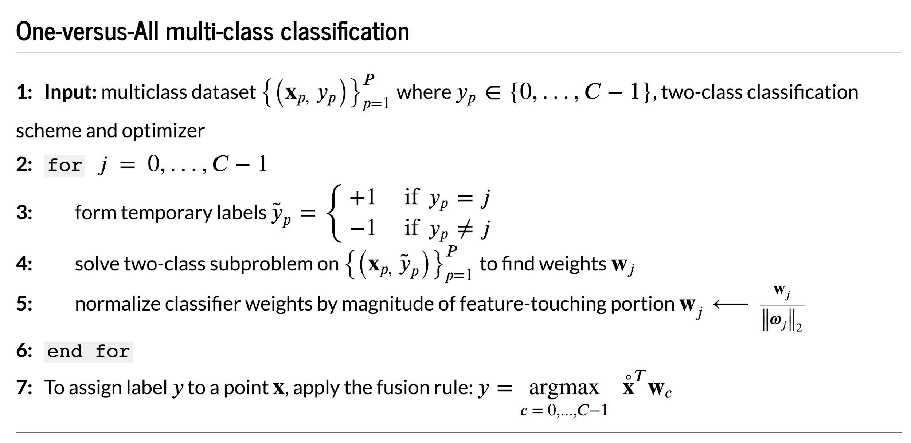

Slide 29
Multiclass decision boundary

Slide 30
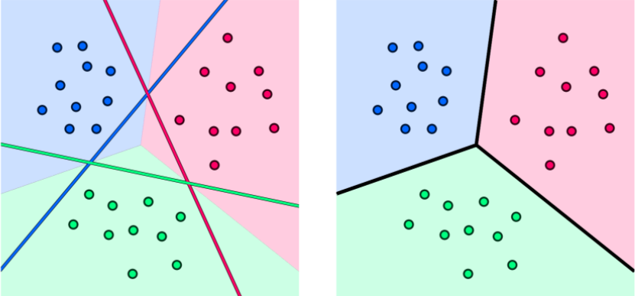

Slide 31
The multi-class boundary (in black) arises at points where the fusion rule does not provide a unique solution
The boundary resulting from the fusion rule is always piecewise-linear.
While the fusion rule explicitly defines this boundary it does not provide us with a closed form formula for it as with e.g., logistic regression.

Slide 32
Implementing a One-versus-All classifier in `Python`

Slide 33
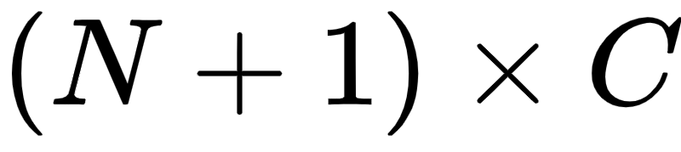
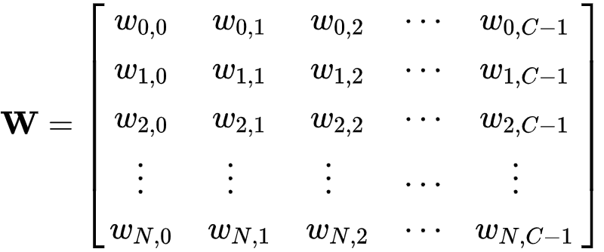
To take advantage of the `numpy` libraries fast array operations we use the notation first introduced in [Section 5.6], we stack the trained weights from our C classifiers together into a single array of the form

Slide 34
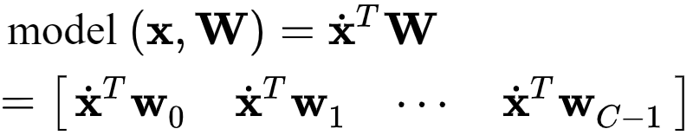
We also extend our `model` notation to denote the evaluation of our C individual linear models as

Slide 35
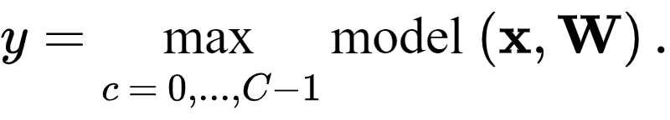
Notice that we can now write the fusion rule in this extended `model` notation equivalently as

Slide 36
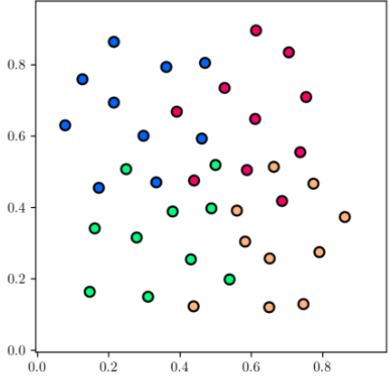
Example: Classifying a dataset with C = 4 classes using OvA

Slide 37
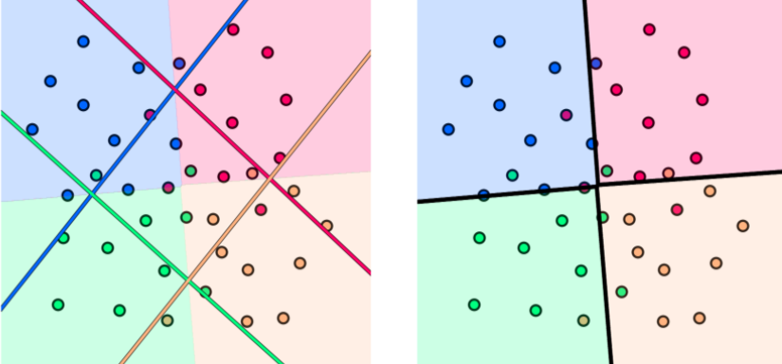
Note with this dataset that each class is *not* linearly separable from the remainder of the data. This is no matter - the OvA framework still produces an appropriate multi-class boundary.

Slide 38
Interpreting the fusion rule as a discrete step function

Slide 39
